Slide 1
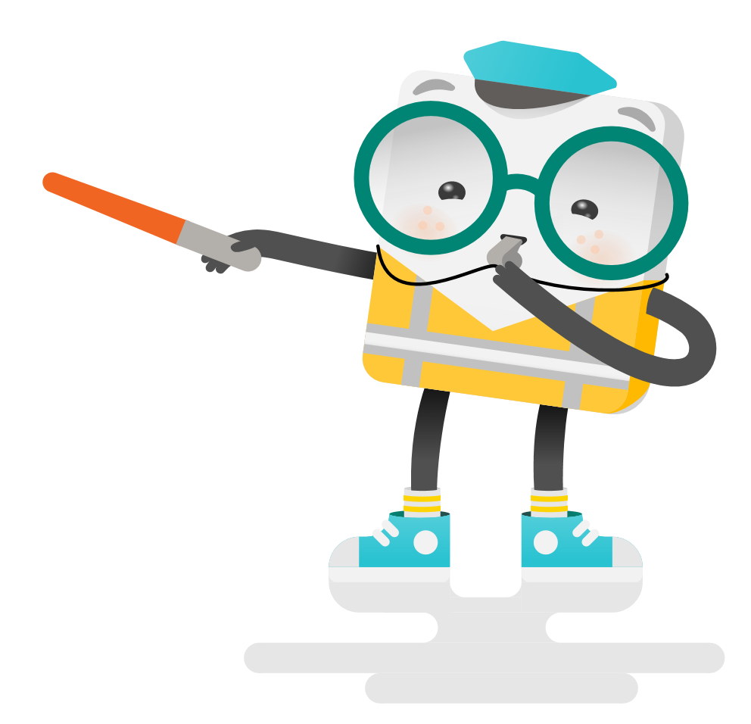
Cloud Native Bootcamp
Cloud Native Bootcamp
Week 1
CONTAINERS WITH DOCKER
2H30
Microsoft invites you for the Cloud Native Bootcamp. In just 4 weeks, you’ll understand the basics of Kubernetes and get hands-on experience with its various components and capabilities, including AKS.
Go from zero to hero with Kubernetes to set your company up for future app development success.
Week 2
KUBERNETES INTRODUCTION
2H00
Week 3
DEVOPS FOR KUBERNETES
4H00
Week 4
KUBERNETES DEEPDIVE & KUBERNETES WORKSHOP
3H00
The Bootcamp is a 4 week program with self-paced learning content separated for each week. In the end of each week you will have a weekly ramp-up email and office hours with extra resources. The bootcamp ends up with a Hands-On Kubernetes Workshop with Microsoft proctors.
Notes:
For ESI customers, the TPM/iTPM must be consulted & provide approval before CSC is implemented. Be sure to always align with TPMs/iTPMs if you are considering running a challenge with ESI customers.
Andrea Waugh Metzger: LOVE Skills Challenge! I had a 60% conversion rate for ACAs last year when I ran challenges

Slide 2
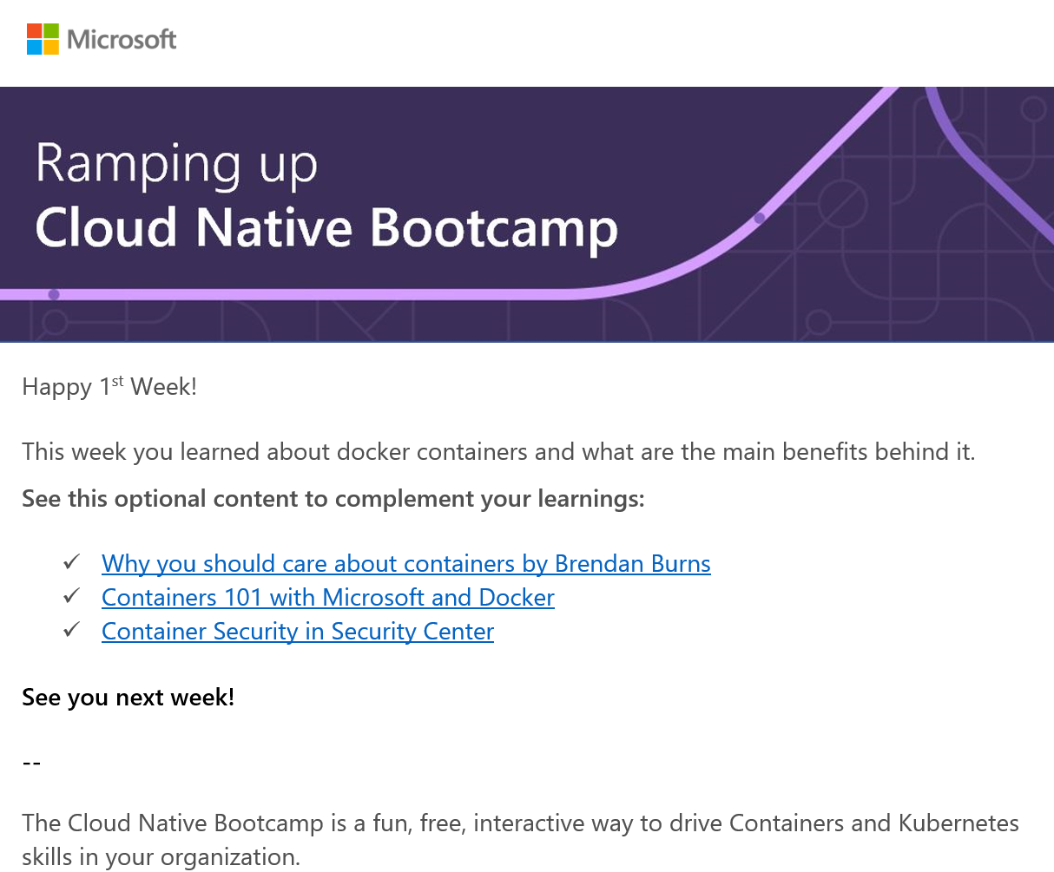
Cloud Native Bootcamp
Kick-Off | March 2021
Weekly Check Up
Weekly call to ramp up on the learning and additional content
Morning Workshop | April 2021
Kubernetes Hands-On Workshop
Notes:
For ESI customers, the TPM/iTPM must be consulted & provide approval before CSC is implemented. Be sure to always align with TPMs/iTPMs if you are considering running a challenge with ESI customers.
Andrea Waugh Metzger: LOVE Skills Challenge! I had a 60% conversion rate for ACAs last year when I ran challenges

Slide 3
Cloud Native Bootcamp Sponsors Calendar
5th March – Send Invites
MON | TUE | WED | THU | FRI
15 | 16 | 17 | 18 | 19 Containers Workshop (Full Day)
22 | 23 | 24 | 25 | 26 Bootcamp Office Hours (1h30)
29 | 30 | 31 | 1 | 2 Bootcamp Office Hours (1h30)
5 | 6 | 7 | 8 | 9 Kubernetes Workshop (Full Day)
Containers 101 self-learning gamification, 2h30
Kubernetes & AKS 101 self-learning gamification, 2h30
DevOps for Kubernetes self-learning gamification, 4h30
Kubernetes Deep Dive self-learning gamification, 3h
Notes:
For ESI customers, the TPM/iTPM must be consulted & provide approval before CSC is implemented. Be sure to always align with TPMs/iTPMs if you are considering running a challenge with ESI customers.
Andrea Waugh Metzger: LOVE Skills Challenge! I had a 60% conversion rate for ACAs last year when I ran challenges

